Slide 1
CMSC201 Computer Science I for Majors Lecture 05 – Comparison Operators and Boolean (Logical) Operators
Prof. Katherine Gibson
Based on slides by Shawn Lupoli and Max Morawski at UMBC

Slide 2
Last Class We Covered
Expressions
Python’s operators
Including mod and integer division
The order of operations
Different variables types
How to cast to a type
Constants (and why using them is important)

Slide 3
Any Questions from Last Time?

Slide 4
Today’s Objectives
To learn a bit about main()
To learn more of Python’s operators
Comparison operators
Logical operators
To practice using these new operators
To become more familiar with using Boolean variables

Slide 5
Quick Note about main()

Slide 6
main()
In Lab 2, we introduced the code
def main():
as the first line of code in our file
main() is an example of a function
We can use functions to organize our code

Slide 7
Functions
We’ll cover functions in more detail later
For now, think of them as something similar to a variable
Variables hold data
Functions hold code

Slide 8
Calling main()
With variables, we use the variable name to access the data they store
We must do the same with functions like main(), using the function name to execute the code they store

Slide 9
Using main() for Your Code
For our purposes, use main() with your code from now on:
def main():
class = int(input("What class is this? ")
print(class, "is awesome!")
main()
declaring our main() function
calling our main() function

Slide 10
Review: Control Structures & Operators

Slide 11
Control Structures
What are the three control structures?
Sequential
Decision Making
Also known as “Selection”
Looping
Also known as “Repetition”
We can also call a function

Slide 12
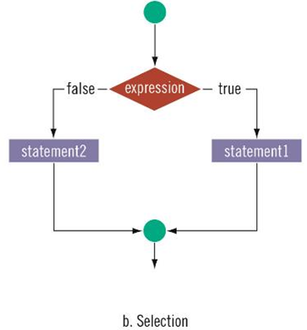
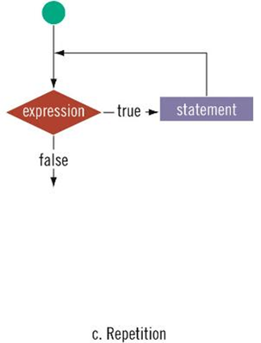
Control Structures: Flowcharts

Slide 13
Types of Operators in Python
✓
Arithmetic Operators
Comparison (Relational) Operators
Assignment Operators
Logical Operators
Bitwise Operators
Membership Operators
Identity Operators
✓
focus of today’s lecture

Slide 14
Comparison Operators

Slide 15
Vocabulary
Comparison operators
Relational operators
Equality operators
Are all the same thing
Include things like >, >=, <, <=, ==, !=

Slide 16
Vocabulary
Logical operators
Boolean operators
Are the same thing
Include and, or, and not

Slide 17
Comparison Operators
Always return a Boolean result
True or False
Indicates whether a relationship holds between their operands
comparison operator
a >= b
operands

Slide 18
Comparison Examples
What is the following comparison asking?
a >= b
Is a greater than or equal to b?
a == b
Is a equal to b?

Slide 19
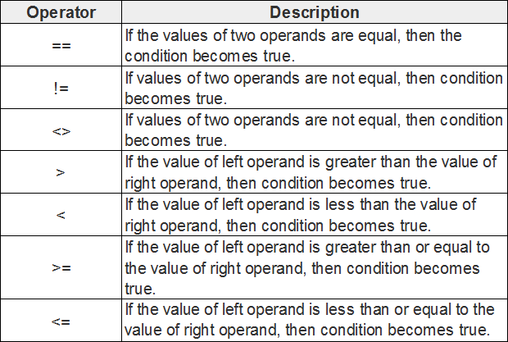
List of Operators
<> is outdated
use != for “not equal to”
http://www.tutorialspoint.com/python/comparison_operators_example.htm

Slide 20
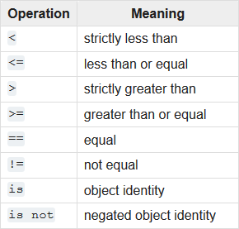
List of Operators (Continued)
https://docs.python.org/3.3/library/stdtypes.html

Slide 21
Comparison Examples (Continued)
What do these evaluate to if a = 10 and b = 20?
a >= b
Is a greater than or equal to b?
Is 10 greater than or equal to 20?
FALSE

Slide 22
Comparison Examples (Continued)
What do these evaluate to if a = 10 and b = 20?
a == b
Is a equal to b?
Is 10 equal to 20?
FALSE

Slide 23
Comparison vs Assignment
A common mistake is to use the assignment operator (=) in place of the relational (==)
This is a very common mistake to make!
What does a=b do?
Sets a equal to b.
What does a==b do?
Asks does a equal b?
This type of mistake will usually not trigger an error!

Slide 24
Comparison Operator Examples

Slide 25
Comparison Operators and Simple Data Types
Examples:
8 < 15 evaluates to True
6 != 6 evaluates to False
2.5 > 5.8 evaluates to False
5.9 <= 7.5 evaluates to True

Slide 26
“Value” of Boolean Variables
When we discuss Boolean outputs, we think
True and False
but we can also think of it in terms of
1 and 0
True = 1
False = 0

Slide 27
Comparison Operation Examples
Prints:
False False True
a = 10
b = 20
c = 30
bool1 = a == b
bool2 = c < b
bool3 = c != a
print(bool1, bool2, bool3)

Slide 28
More Comparison Operation Examples
Prints:
1 False 3
a = 10
b = 20
c = 30
bool1 = int(a==a)
bool2 = a==a >= 10
bool3 = (a==a) + (b==b) + (c==c)
print(bool1, bool2, bool3)

Slide 29
Logical Operators

Slide 30
Logical Operators
There are three logical operators:
and
or
not
They allow us to build more complex Boolean expressions
By combining simpler Boolean expressions

Slide 31
Logical Operators – and
Let’s evaluate this expression
bool1 = a and b
Value of a | Value of b | Value of bool1

Slide 32
Logical Operators – and
Let’s evaluate this expression
bool1 = a and b
Value of a | Value of b | Value of bool1
True | True | True
True | False | False
False | True | False
False | False | False

Slide 33
Logical Operators – and
Let’s evaluate this expression
bool1 = a and b
For a and b to be True, both a and b must be true
Value of a | Value of b | Value of bool1
True | True | True
True | False | False
False | True | False
False | False | False

Slide 34
Logical Operators – and
Two ways to write and expressions
Explicitly use the keyword:
3 > 2 and 2 > 1
String them together, like in math:
x > y > z
Evaluates to x > y and y > z

Slide 35
Examples of and
Prints:
True True True
a = 10
b = 20
c = 30
ex1 = a < b < c
ex2 = a < b and b < c
ex3 = a+b==c and b-10==a and c/3==a
print (ex1, ex2, ex3)

Slide 36
More Examples of and
Prints:
False False True
a = 10
b = 20
c = 30
bool1 = a > b > c
bool2 = a == b > c
bool3 = a < b < c
print(bool1, bool2, bool3)

Slide 37
Logical Operators – or
Let’s evaluate this expression
bool1 = a or b
Value of a | Value of b | Value of bool1

Slide 38
Logical Operators – or
Let’s evaluate this expression
bool1 = a or b
Value of a | Value of b | Value of bool1
True | True | True
True | False | True
False | True | True
False | False | False

Slide 39
Logical Operators – or
Let’s evaluate this expression
bool1 = a or b
For a or b to be True, either a or b must be true
Value of a | Value of b | Value of bool1
True | True | True
True | False | True
False | True | True
False | False | False

Slide 40
Examples of or
Prints:
False True True
a = 10
b = 20
c = 30
ex1 = a > b or c < b
ex2 = a + b <= c + 1 or b > c
ex3 = a == c or b + 10 <= a or c/3 == a
print (ex1, ex2, ex3)

Slide 41
Logical Operators – not
Let’s evaluate this expression
bool1 = not a
not a returns the opposite Boolean value of a
Value of a | Value of bool1
True | False
False | True

Slide 42
Complex Expressions
We can put multiple operators together!
bool1 = a and (b or c)
What does Python do first?
Computes (b or c)
Computes the and with a and the result

Slide 43
Complex Expression Example
bool1 = a and (b or c)
Value of a | Value of b | Value of c | Value of bool1
True | True | True | True
True | True | False | True
True | False | True | True
True | False | False | False
False | True | True | False
False | True | False | False
False | False | True | False
False | False | False | False

Slide 44
“Short Circuit” Evaluation

Slide 45
Short Circuit Evaluation
“and” statements short circuit as soon as an expression evaluates to False
“or” statements short circuit as soon as an expression evaluates to True

Slide 46
Short Circuiting – and
Notice that in the expression:
bool1 = a and (b or c)
If a is False
The rest of the expression doesn’t matter
Python will realize this, and if a is false won’t bother with the rest of the expression

Slide 47
Short Circuiting – or
Notice that in the expression:
bool1 = a or (b or c)
If a is True
The rest of the expression doesn’t matter
Python will realize this, and if a is true won’t bother with the rest of the expression

Slide 48
More Practice
Given:
a = 4
b = 5
c = 6
d = True
e = False
bool1 = d and (a > b)
False
bool2 = (not d) or (b != c)
True
bool3 = (d and (not e)) or (a > b)
True
bool4 = (a%b==2) and ((not d) or e)
False

Slide 49
More More Practice
Given:
a = 4
b = 5
c = 6
d = True
e = False
bool1 = (d + d) >= 2 and (not e)
True
bool2 = (not e) and (6*d == 12/2)
True
bool3 = (d or (e)) and (a > b)
False

Slide 50
Numbers and Booleans
Python accepts anything that is non-zero as True
There are some exceptions, but we’ll get into those later
So technically you can use any integer as a Boolean expression

Slide 51
Decision Making
So, why do we care about comparison operators and logical operators so much?
Answer: Next Class

Slide 52
Announcements
Your Lab 3 is meeting normally this week!
Make sure you attend your correct section
Homework 2 is out
Due by Tuesday (Sept 15th) at 8:59:59 PM
Homeworks are on Blackboard
Weekly Agendas are also on Blackboard

